Slide 1
Full Stack Application Development
Application Development- Introduction
Web application architectures
Evolution of Web application architectures
Akshaya Ganesan

Slide 2
Evolution of Web application architectures

Slide 3
Layered Pattern
Context: Separation of concern
Problem: Modules of the system may be independently developed and maintained, supporting portability, modifiability, and reuse.
Solution: The layered pattern divides the software into units called layers.
Each layer is a grouping of modules that offers a cohesive set of services.
Each partition is exposed through a interface.
Layers interact according to a strict ordering relation and unidirectional.

Slide 4
Web Application
Web application follows the Layered Architecture.
Two-layer systems
Typical client-server system
The client held the user interface and other application code, and the server was usually a relational database.
Embed the logic directly into the UI screens
Alternative: put the domain logic in the database as stored procedures.

Slide 5
3-Tier Architecture
A typical Web Application:
Presentation (UI)
Business Logic
Data Access

Slide 6
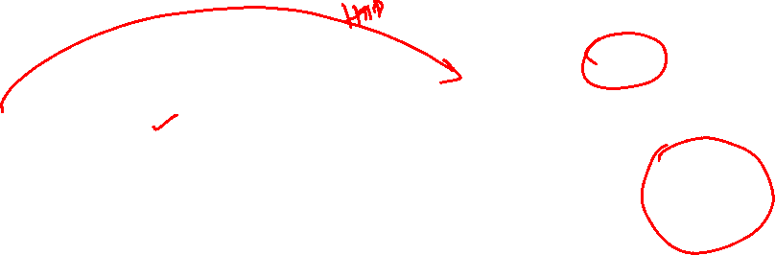
Traditional Web Application
Three Tier
Web Server
Business Logic
HTML
CSS
JS
Client(Browser)
Presentation Logic
Static content
Client Tier
Internet
Server Tier
Data Tier

Slide 7
Ensuring a clear separation of concern
Scenario 1: A list of products in which all the products that sold over 10 percent more than they did the previous month were coloured in red.
Method 1: (putting domain logic into the presentation)
Developers placed logic in the presentation layer that compared this month’s sales to last month’s sales, and if the difference was more than 10 percent, they set the colour to red.

Slide 8
Ensuring a clear separation of concern
Scenario 1: A list of products in which all the products that sold over 10 percent more than they did the previous month were coloured in red.
Method 2: To properly separate the layers, you need a method in the domain layer to indicate if a product has improved sales. This method makes the comparison between the two months and returns a Boolean value.
The presentation layer then calls this Boolean method and, if true, highlights the product in red.

Slide 9
Ensuring a clear separation of concern
Scenario 2:You need to add different layers to an application, such as a command-line interface to a Web application.
Method: If there’s any functionality you have to duplicate to do this, that’s a sign of where domain logic has leaked into the presentation
Similarly, do you have to duplicate logic to replace a relational database with an XML file?

Slide 10
N-Tier Web Application
Client(Browser)
Internet
DB
Client(Browser)
Web Server
Application Server
HTML
Client(Browser)
CSS
JS
Client Tier
Internet
Server Tier
Business Tier
Data Tier

Slide 11
Characteristics
Each tier is completely independent.
The nth tier only has to know how to handle a request from the n+1th tier
Tiers make it easier to ensure security and to optimize performance and availability in specialized ways.

Slide 12
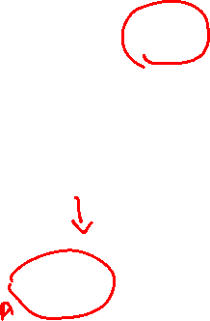
Service Based Web Application
Third Party APIs
Client(Browser)
Internet
DB
Client(Browser)
Web Server
Application Server
HTML
Client(Browser)
CSS
JS
REST API
DB
Client Tier
Internet
Server Tier
Business Tier
Data Tier

Slide 13
Evolution of Web Applications

Slide 14
Thank You!

